Slide 1
Data Perikanan Mawasangka Tengah
Total landings
CPUE
Size Structure

Slide 2
Total Landings in MAR Masteng
30
Increased
Total landings(kg)
20
10
0
Jul 2022
Jan 2023
Jul 2023
Jan 2024
Jul 2024
Jan 2025
Jul 2025

Slide 3
Catch Per Unit Effort in MAR Masteng
20
15
Increased
CPUE (kg/fisher/trip)
10
5
0
Jul 2022
Jan 2023
Jul 2023
Jan 2024
Jul 2024
Jan 2025
Jul 2025

Slide 4
Baronang
Siganus guttatus
Jumlah data dari Kawasan, kurang untuk dianalisa

Slide 5
Sunu Merah
Cephalopholis miniata

Slide 6
Total Landings c.miniata in MAR Masteng
3
2
Decreased
Total landings(kg)
1
0
Oct 2022
Apr 2023
Oct 2023
Apr 2024
Oct 2024

Slide 7
Catch Per Unit Effort c.miniata in MAR Masteng
3
Decreased
2
CPUE (kg/fisher/trip)
1
0
Oct 2022
Apr 2023
Oct 2023
Apr 2024
Oct 2024

Slide 8
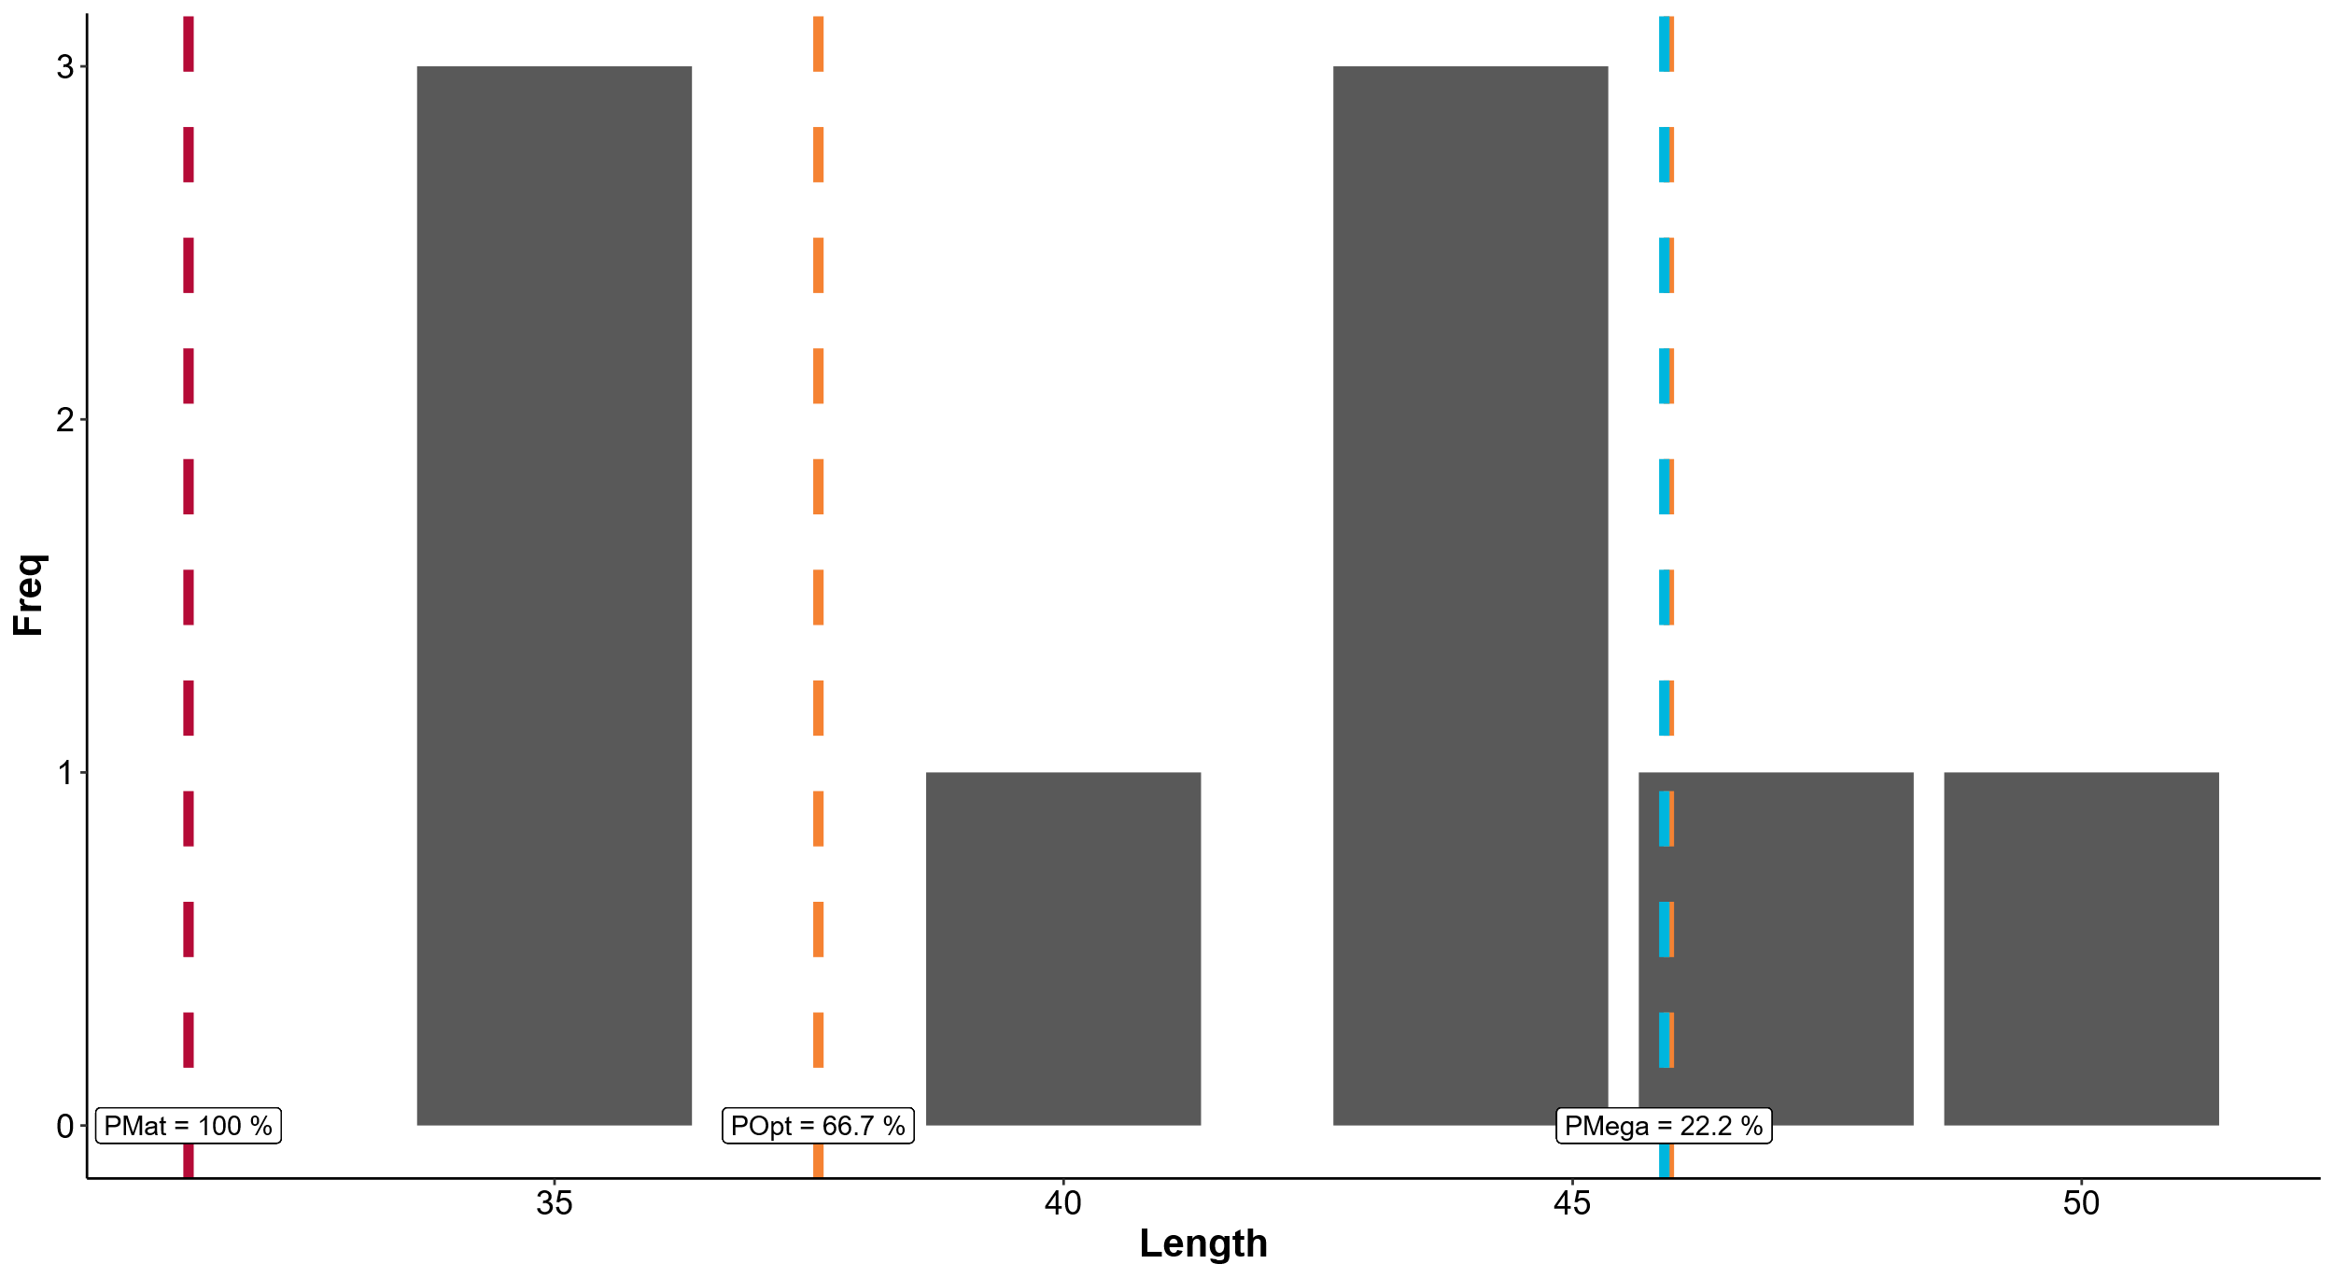

Slide 9
Kerapu Lumpur
Epinephelus malabaricus
Tidak ada data di kawasan

